Slide 1
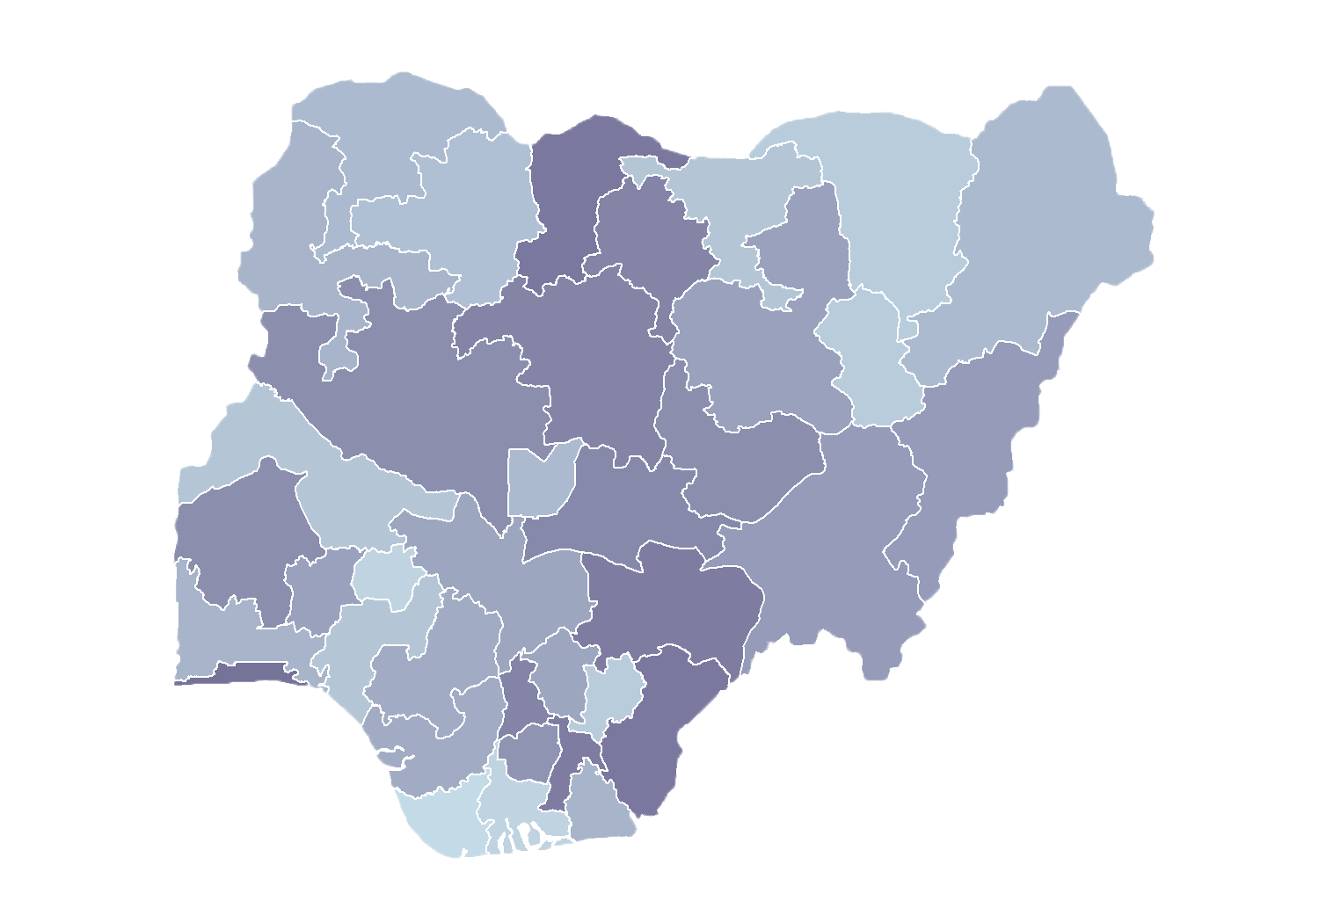
Module 2.1
Introduction to Health Facility Registry Data Collection Form
Rollout of Health Facility Registry/Master Facility List
for States and Local Government Areas
in Nigeria
March 2019

Slide 2
Outline
Steps to establish a master
facility list (MFL)
Data in the health facility registry (HFR)
Hospital and clinic data collection form
Data definitions for signature domain
Data definitions for service domain
Quiz

Slide 3

Process for establishing a
master facility list

Slide 4

Steps to establish an MFL
Through consultative process, TWG identified minimum data set to be included in the MFL
in 2015
LGA authorities will integrate MFL data collection in routine facility visits in 2019
Visit facilities to complete and verify data
Determine what data the MFL
will contain
Identify available lists and assess content
Lists were collected from different national programs in 2016
Identify new sources of facility data
State and LGA authorities will begin entering data directly in the HFR 2019
Choose best list
to use as a starting point
Design HFR and upload MFL
The lists were merged and validated at state level
in 2017
MEASURE Evaluation
supported the Federal Ministry of Health (FMOH) from 2017–2019

Slide 5

Data in the HFR
January 2019

Slide 6
Types of data
Signature domain
Service domain
Information that can be used to uniquely identify, locate, and contact the facility
Should not
change substantially
over time
Could be considered minimum data content
Describe the basic services, infrastructure, and human resources at a facility
Critical for planning and resource allocation
Tend to change
more frequently
Notes:
Usually, data pertaining to the signature domain is critical to a MFL and should take precedence over data describing services offered at the facility.
Necessary to get a baseline around how many facilities exist in Nigeria
Careful consideration was given when selecting minimum service domain data elements given budget implications for collecting and maintaining these data.

Slide 7
Signature domain
Signature domain
Facility name and ID
States and LGAs
Wards
Geocoordinates
Contact information
Level of care
Ownership
Status
100%
100%
0%
61%
0%
100%
100%
0%
Notes:
Takeaways:
Significant amount of signature domain data has been culled from existing lists
SQUAD tool will provide more details on how to do this
Next edge here is to improve disaggregates for both level of care and ownership
Finally, the information related to status is entirely missing (operational, registration, and licensure status)

Slide 8
Signature domain
Signature domain
Focus on collecting missing geocoordinates and identifying duplicates!
Facility name
Administrative location
Geocoordinates
Contact information
Level of care
Ownership
Status
The result will be a credible MFL of facilities in Nigeria
Notes:
Takeaways:
Significant amount of signature domain data has been culled from existing lists
SQUAD tool will provide more details on how to do this
Next edge here is to improve disaggregates for both level of care and ownership
Finally, the information related to status is entirely missing (operational, registration, and licensure status)

Slide 9
Signature domain
Signature domain
Facility name
Administrative location
Geocoordinates
Contact information
Level of care
Ownership
Status
Ensure that each facility has contact information
Regular updates
can be made by communicating with contact person
Notes:
Takeaways:
Significant amount of signature domain data has been culled from existing lists
SQUAD tool will provide more details on how to do this
Next edge here is to improve disaggregates for both level of care and ownership
Finally, the information related to status is entirely missing (operational, registration, and licensure status)

Slide 10
Signature domain
Signature domain
The result will allow authorities to perform regulatory functions!
Facility name
Administrative location
Geocoordinates
Contact information
Level of care
Ownership
Status
By collecting data on status:
Operational?
Registered?
Licensed?
Notes:
Takeaways:
Significant amount of signature domain data has been culled from existing lists
SQUAD tool will provide more details on how to do this
Next edge here is to improve disaggregates for both level of care and ownership
Finally, the information related to status is entirely missing (operational, registration, and licensure status)

Slide 11
Service domain
At present, the HFR does not contain any service domain information.
It is likely that existing sources of information could be leveraged to complete missing data.
While collecting priority signature domain data, recommend to collect as much of the service domain information as possible, simultaneously.
Service domain
Type of services
Number of beds
Human resources
The result will enhance health facility management!

Slide 12

Hospital and clinic
data collection form

Slide 13
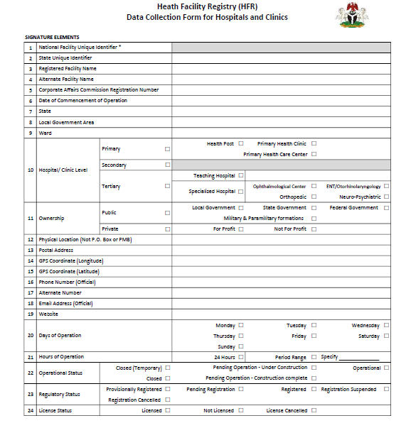
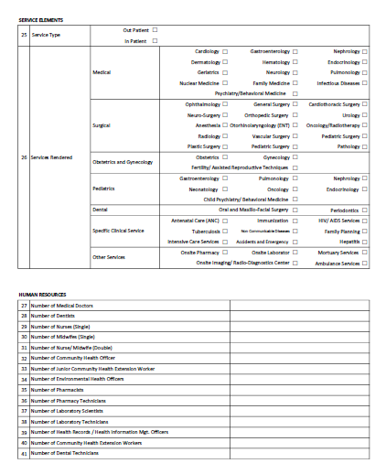
Hospital and clinic
data collection form
Accessible at: https://hfr.health.gov.ng/resources

Slide 14
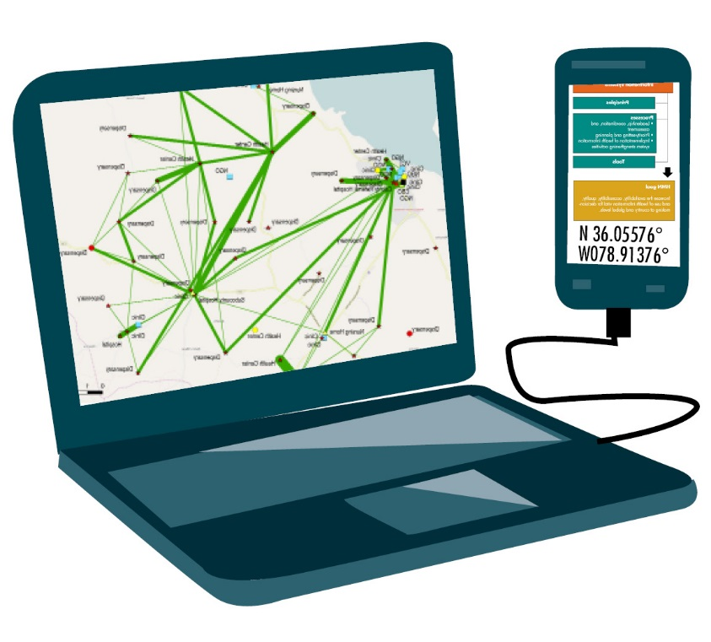
Signature domain
page one

Slide 15
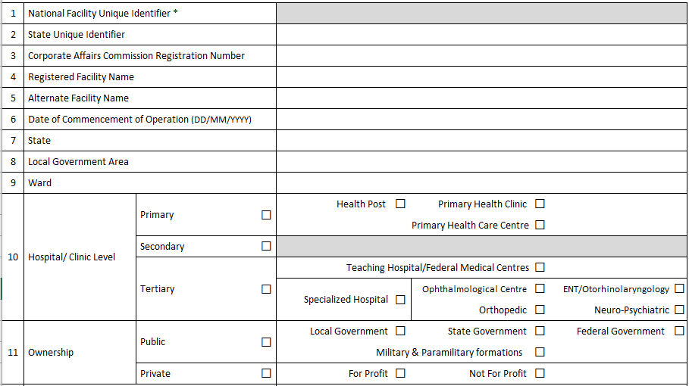
Signature domain

Slide 16
Signature domain
Identifiers
National facility unique identifier
Number generated by the HFR system and will never change; to be transcribed from the HFR
after the facility has been created
State unique identifier
Unique number given by state for a facility
Corporate Affaires Commission registration number
Registration number which is provided by Corporate Affairs Commission when a
company is registered

Slide 17
Signature domain
Date and names
Registered name
Official (business) name of the health facility;
source: registration certificate
Alternate name
Any other name used to describe the health facility, including colloquial alternative naming
of the facility
Date of commencement of operation
Date when the facility started operation. If date is not known, estimate year (enter 01/01/2006)

Slide 18
Signature domain
Administrative units
State
Name of the state where the facility belongs
Local government area (LGA)
Name of the LGA where the facility belongs
Ward
Name of the ward where the facility belongs

Slide 19
Signature domain
10. Hospital/clinic level
  Primary level of care
      Health post
      Primary health clinic
      Primary healthcare center
  Secondary level of care
  Tertiary level of care
      Teaching hospital
      Specialized hospital
        Ophthalmological center
        ENT/otorhinolaryngology
        Orthopedic
        Neuropsychiatric

Slide 20
Signature domain
11. Ownership
Public
    Local government
    State government
    Federal government
    Military and paramilitary formations
Private
    For profit
    Nonprofit
Notes:
Definition: Ownership means the power or authority of having exclusive legal rights to the facility, which includes the right to possess, use, and dispose of said facility.
However, for the purposes of this implementation guide, ownership, especially for the faith-based facilities, will be classified as “private.”
At registration, the government officer responsible for facility registration (at LGA, state, or federal) determines the owner of the facility, and the national regulatory body that will/has registered the facility.
Unlike facility type and level, which are functions of gazette and accreditation, ownership is inherent at registration. It can only change through executive orders and legal processes governing transfer of ownership for such a category of property (facility).
There are two categories of health facility ownership namely public and private. The public ownership may be further categorized to the federal, state and LGA, faith-based organizations, nongovernmental organizations, and private.

Slide 21
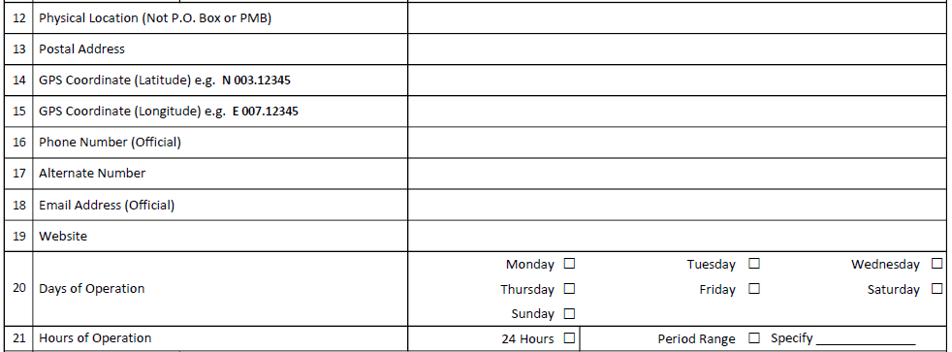
Signature domain

Slide 22
Signature domain
Location
Physical location (not P.O. box or PMB)
Physical address of the facility, which includes street and house number for each facility
Postal address
The postal address is the official address for mail and should include P.O. box and town (for example: P.O. Box 25, Ado-Awaye)
GPS coordinates
Longitude and latitude coordinates

Slide 23
Signature domain
Contacts
Physical location (not P.O. box or PMB)
Physical address of the facility, which includes street and house number for each facility
Phone number (official)
Alternate number
Email address (official)
Type in the general email contact of the facility. Example: info_babaginaPHC@state_name.gov.ng
Website
This is the official website of the facility or organization managing the facility where more information about the facility can be found.

Slide 24
Signature domain
Open times
Days of operation
This describe days when the facility provides services (Monday, Tuesday, …, Sunday)
Hours of operation
This describes operating hours for the facility.
There are two options for this data element:
      24 hours
      Or specify hours of operation: for example,
      8am–4pm

Slide 25
Signature domain
22. Operational status
  Operational
  Pending operational — under construction
  Pending operational — construction complete
  Closed (temporary)
  Closed
Notes:
Operational: This status is for a facility that is already offering services.
Pending operational — under construction: This status is for a facility that is still under construction and not yet licensed to start offering services.
Pending operational — construction complete: This status is for a facility that has not yet started offering services, but construction is complete.
Closed (temporary): This is a facility that is not offering services and it is expected it will start offering services again at that premises.
Closed: This is a facility that is not offering services and is not expected to ever start offering services at that premises.
Data source: The government officers responsible for registration and accreditation (at LGA, state, or federal) are responsible for maintaining the operational status at a defined frequency of update.

Slide 26
Signature domain
23. Registration status
  Provisionally registered
  Pending registration
  Registered
  Registration suspended
  Registration cancelled
Notes:
Provisionally registered: This is a facility that has received temporary approval by the government officer responsible for registration and accreditation (at LGA, state, or federal) as an Institution subject to address identified issues.
Pending registration: This is a facility that has been approved by the government officer responsible for registration and accreditation (at LGA, state, or federal) as an Institution and a request for registration sent the State Hospital Management Board or Department of the Hospital Services.
Registered: This is a facility that has been approved as an institution by the state office responsible for registration and a registration number given.
Registration suspended: A facility whose registration has been temporarily stopped for reasons including self-request, sickness, disciplinary action, etc., is known as “registration suspended.”
Registration cancelled: A facility whose registration has been permanently stopped by the national body is known as “registration cancelled.”

Slide 27
Signature domain
24. License status
  Licensed
  Not licensed
  License cancelled
Notes:
Licensed: A facility that has been approved and issued a license by the appropriate national regulatory body is called “licensed.”
Not licensed: A facility that has not been approved and issued a license by the appropriate national regulatory body is called “not licensed.”
License cancelled: A facility whose license has been permanently stopped by the national body is known as “license cancelled.”

Slide 28

Service domain
page two

Slide 29
Service domain
Service types

Slide 30
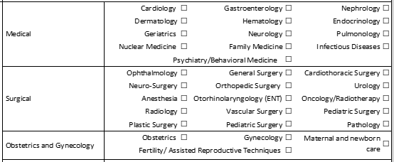
Service domain
Services rendered

Slide 31
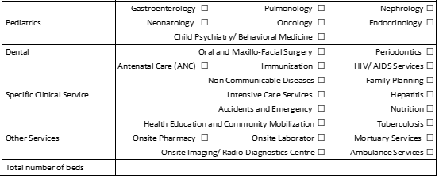
Service domain
Services rendered

Slide 32
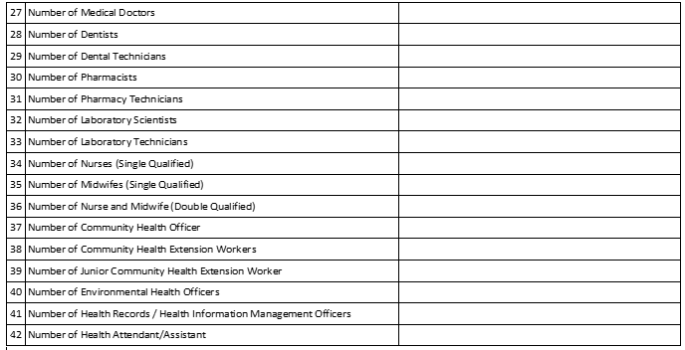
Service domain
Human resources

Slide 33
Discussion

